Slide 1
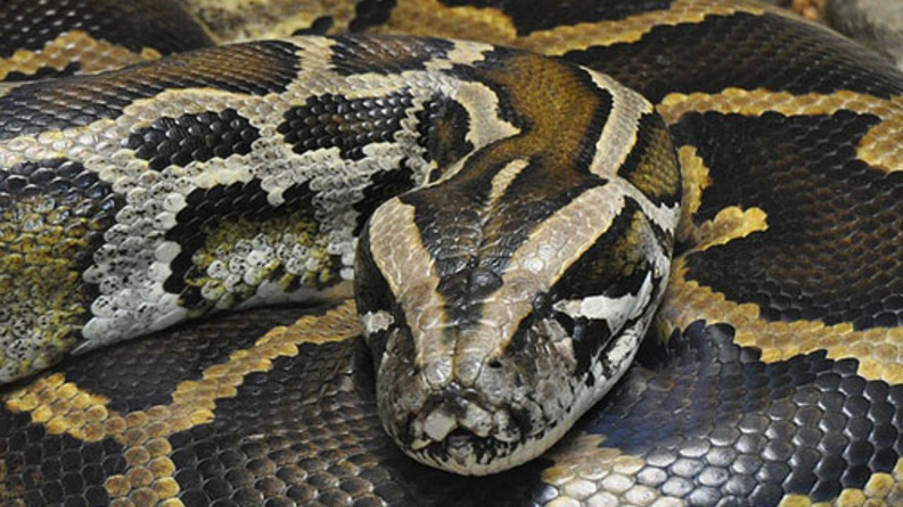
PYTHON

Slide 2
Different editors and installation of Python , Simple programs in Python

Slide 3
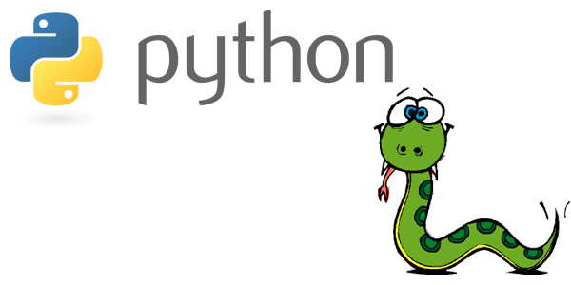
Introduction to

Slide 4
Python Introduction
Python is a general-purpose interpreted, interactive, object-oriented, and high-level programming language.
It was created by Guido van Rossum during 1985- 1990. Python is named after a TV Show called ‘Monty Python’s Flying Circus’ and not after Python-the snake.

Slide 5
Features of Python
Simple
Easy to Learn
Free and Open Source
High-level Language
Python is a Beginner's Language
Portable
Interactive
Interpreted
Object Oriented
Extensible
Embeddable
Extensive Libraries
Databases
GUI Programming
Scalable

Slide 6
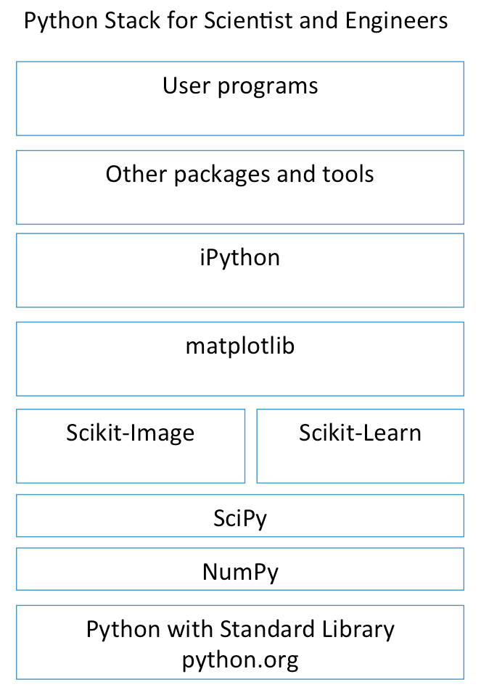
Python Software Stack for Science and Engineering
Python by itself is not that useful for S&E
Many add-ons and extensions have been created to allow python to work for S&E’s, web development, big data processing, and other software “stacks”.
iPython is now called Jupyter

Slide 7
Use Python for…
Web Development: Django, Pyramid, Bottle, Tornado, Flask, web2py
GUI Development: tkInter, PyGObject, PyQt, PySide, Kivy, wxPython
Scientific and Numeric: SciPy, Pandas, IPython
Software Development: Buildbot, Trac, Roundup
System Administration: Ansible, Salt, OpenStack

Slide 8
Programming Editors
Python 3.6 Command Prompt
Python 3.6 Idle
Anaconda Prompt
Anaconda Jupyter Notebook
Anaconda Spider
JetBrains PyCharm

Slide 9
Python 3.6

Slide 10
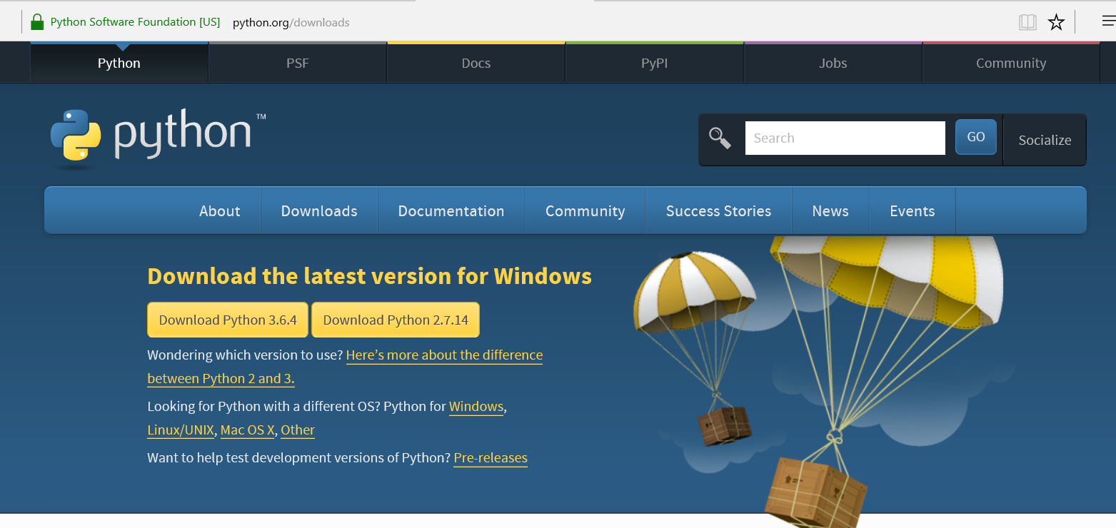
Python3.6 Installation
Go to web page : https://www.python.org/downloads/

Slide 11
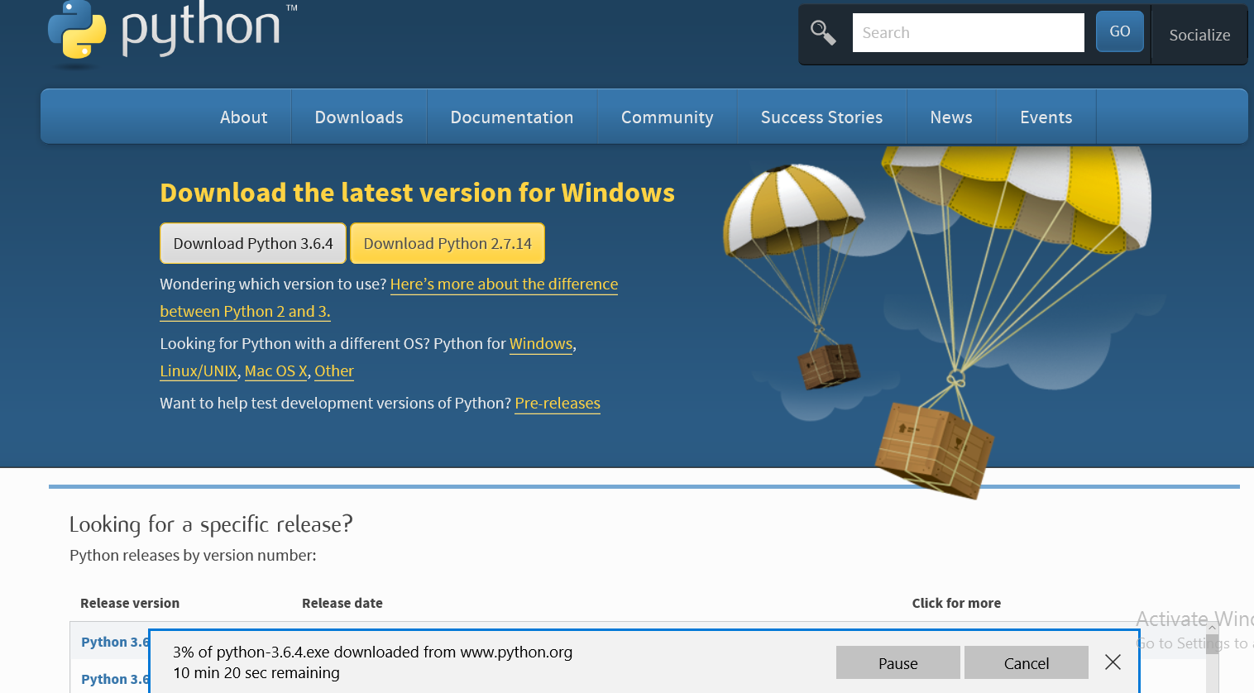

Slide 12
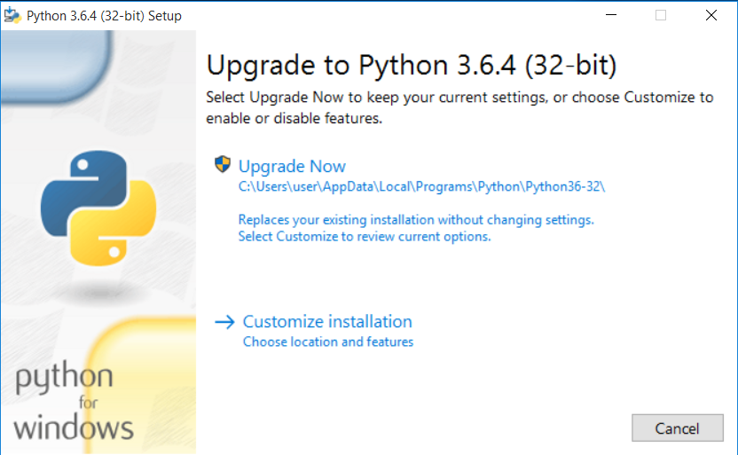

Slide 13
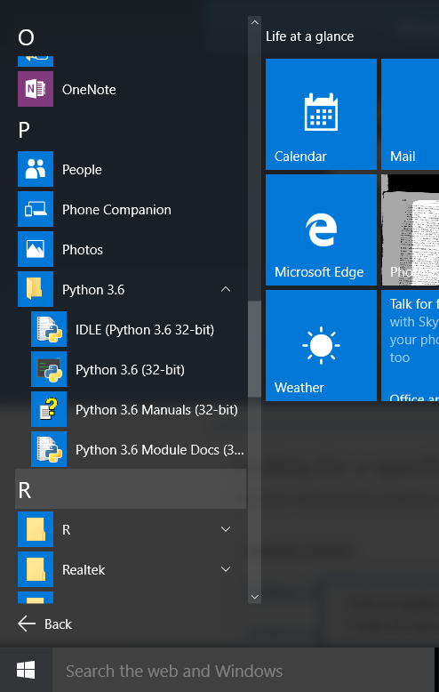

Slide 14
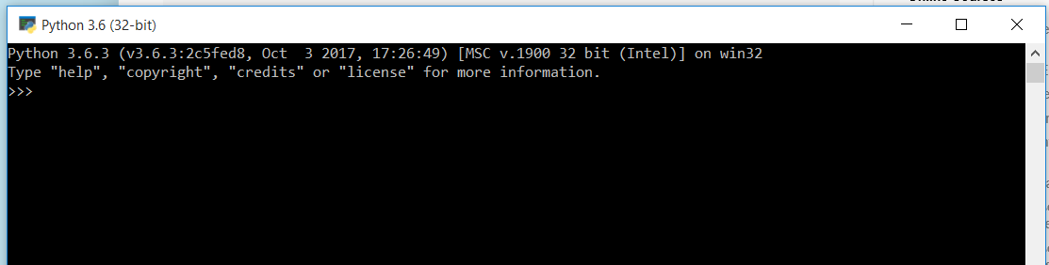
Interactive Python Programming

Slide 15
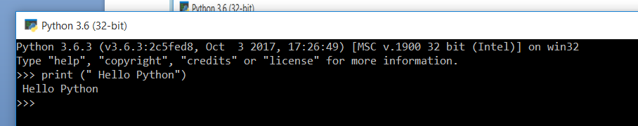

Slide 16
Interactive mode python programming
Sample Example Set1
>>> print "Hello, Python!";
>>> print(1+1)
>>> 1+2
>>> hello
>>>help()

Slide 17
HELP
>>>help()
Welcome to Python 3.6 help utility ! ...
help> if
help> while
help> for
help> string
help> or
help> is
help> and
help> q

Slide 18
Simple calculations in Python
>>> 3.14*5
15.700000000000001
>>> 35/6
5.833333333333333
>>> hex(1024)
'0x400'
>>> bin(1024)
'0b10000000000'
>>>sqrt(4)
>>> from math import *
>>> sqrt(2)
1.4142135623730951
>>> from math import *
>>> sqrt(2)
1.4142135623730951

Slide 19
Calculate the perimeter of a circle
>>> from math import *
>>> diameter = 5
>>> perimeter = 2 * pi * diameter
>>> print(perimeter)
31.41592653589793

Slide 20
Calculate the amplitude of a sine wave:
>>> from math import *
>>> Ueff = 230
>>> amplitude = Ueff * sqrt(2)
>>> amplitude 325.2691193458119

Slide 21
Add, Sub, Mult and Div
>>> x= 5
>>>y =3
>>>x + y
8
>>>x*y
15
>>>x-y
2
>>>x/y
1.6666666667

Slide 22
Reading input
>>> s = input("What is your name?")
What is your name ? XYZU
>>>t
XYZU
>>> print(“your name is :”+t)
Your name is XYZU

Slide 23
Input with data conversion
>>> x = int(input("Input an integer: "))
------
>>>y = float(input("Input a float: "))
-----
>> print(x,y)

Slide 24
Writing Function
def f():
... x = int(input("Enter first Number"))
... y = int(input("Enter second Number"))
... z = x + y
... print(z)
...
>>> f()
Enter first Number 2
Enter second Number 3
5

Slide 25
Type
>>> x = 5
>>> type(x)
<class 'int'>
>>> x= "THYAGU"
>>> type(x)
<class 'str'>
>>>

Slide 26
Built in Functions
>>> int(5.5)
5
>>> float(5)
5.0
>>> str(67)
'67'

Slide 27
Date and Time
>>> import time
>>> localtime = time.localtime(time.time())
>>> print("Local Time:",localtime)
Local Time: time.struct_time(tm_year=2018, tm_mon=1, tm_mday=21, tm_hour=12, tm_min=34, tm_sec=18, tm_wday=6, tm_yday=21, tm_isdst=0)

Slide 28
Getting formatted date and time:
>>> import time
>>> localtime=time.asctime(time.localtime(time.time()))
>>> print("Local Time:",localtime)
Local Time: Sun Jan 21 12:36:54 2018

Slide 29
Getting Calendar for a month
>>> import calendar
>>> c=calendar.month(2018,1)
>>> print("Calendar of January ,2018\n",c)
Calendar of January ,2018
January 2018
Mo Tu We Th Fr Sa Su
1 2 3 4 5 6 7
8 9 10 11 12 13 14
15 16 17 18 19 20 21
22 23 24 25 26 27 28
29 30 31
>>> calendar.prcal(2018)

Slide 30
Script Programming using Idle

Slide 31
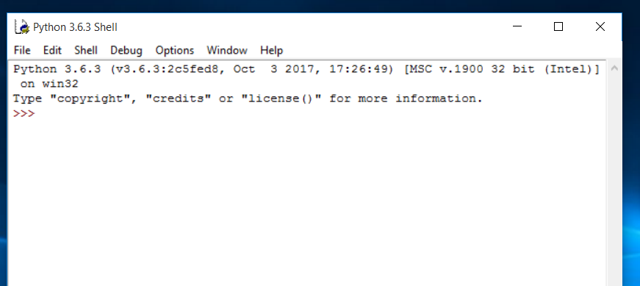

Slide 32
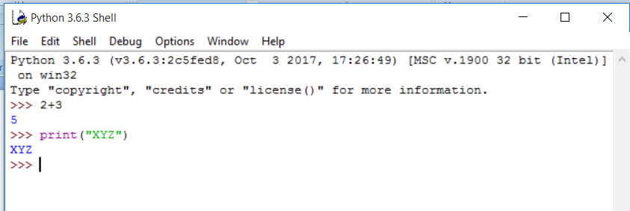

Slide 33
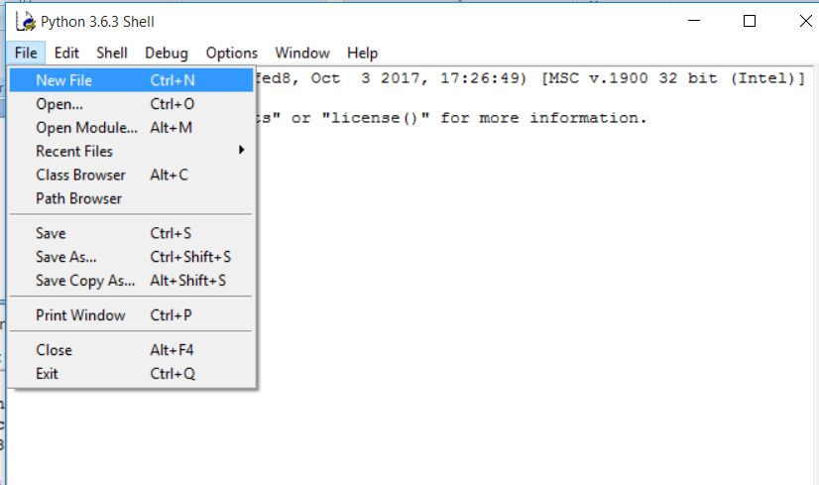

Slide 34
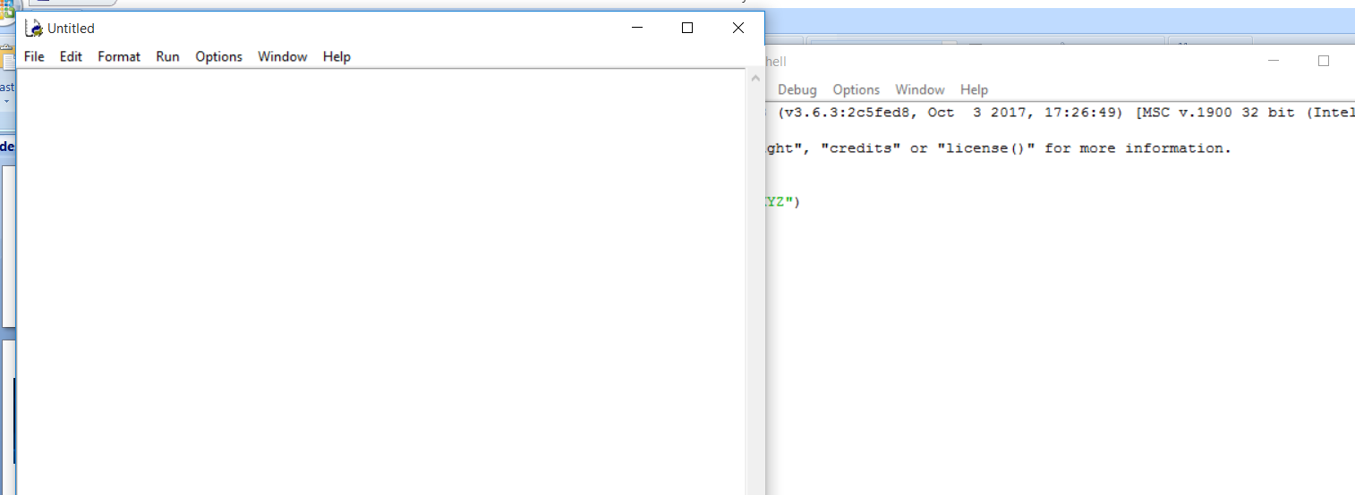

Slide 35
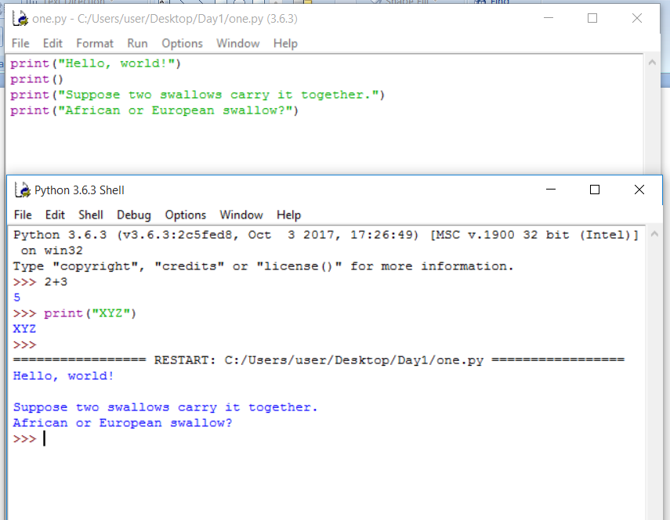

Slide 36
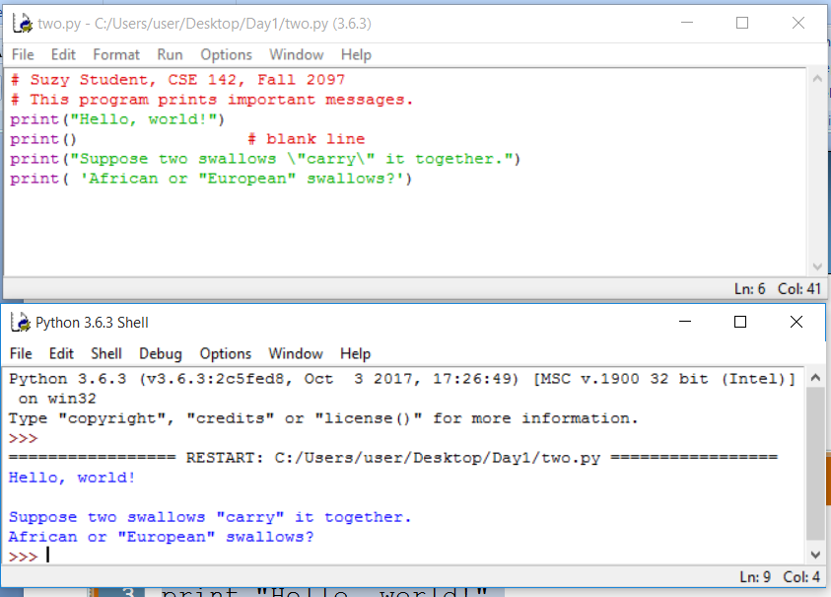

Slide 37
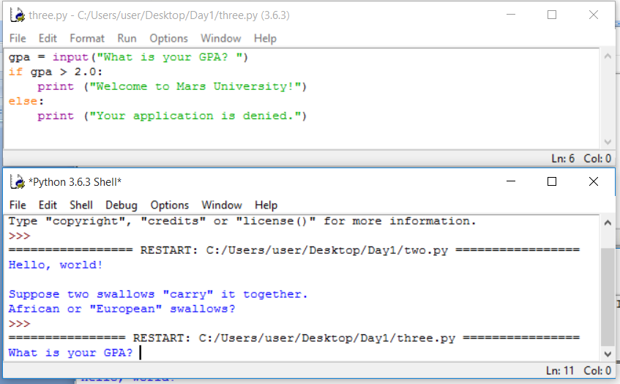

Slide 38
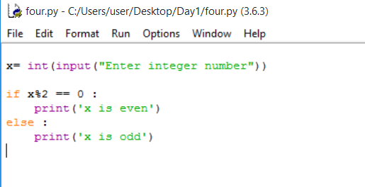

Slide 39
Try this
# Addition and subtraction
print(5 + 5)
print(5 - 5)
# Multiplication and division
print(3 * 5)
print(10 / 2)
# Exponentiation
print(4 ** 2)
# Modulo
print(18 % 7)

Slide 40
What is Anaconda?
With over 4.5 million users, the open source Anaconda Distribution is the easiest way to do Python data science and machine learning.
It includes hundreds of popular data science packages and the conda package and virtual environment manager for Windows, Linux, and MacOS.
Conda makes it quick and easy to install, run, and upgrade complex data science and machine learning environments like scikit-learn, TensorFlow, and SciPy.
Anaconda Distribution is the foundation of millions of data science projects as well as Amazon Web Services' Machine Learning AMIs and Anaconda for Microsoft on Azure and Windows.

Slide 41
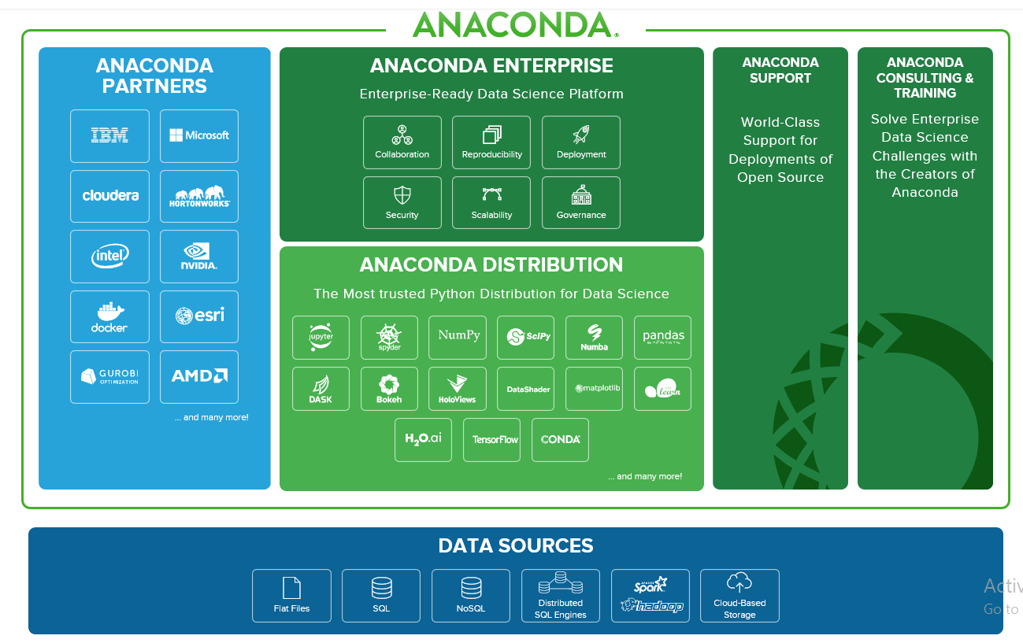

Slide 42
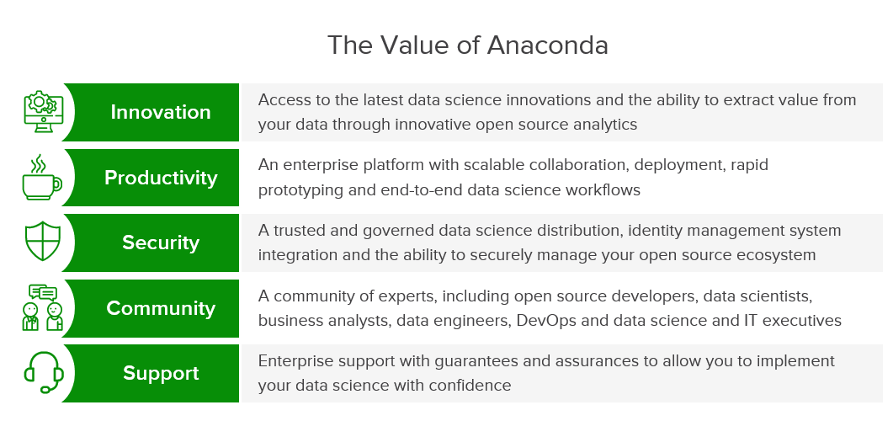

Slide 43
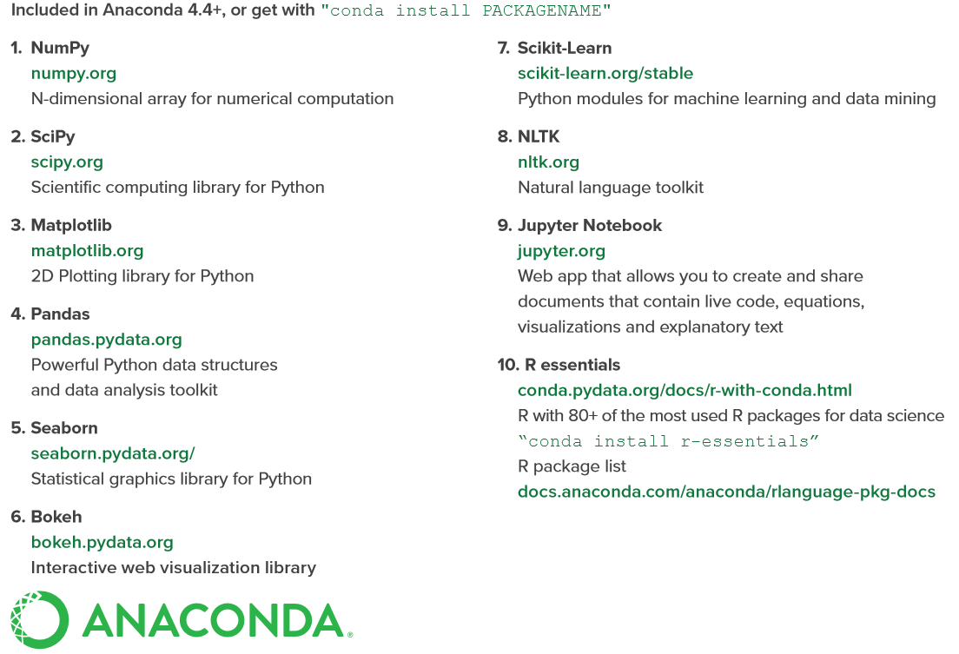

Slide 44
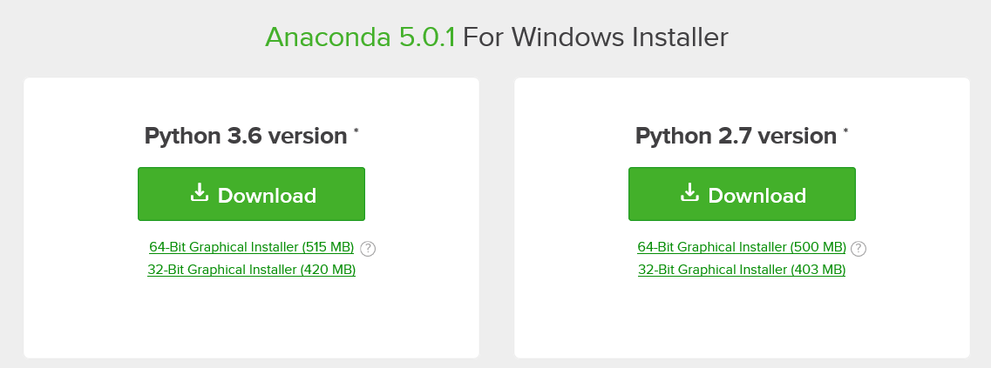
Downloading Anaconda
The latest version of Anaconda is available for download from https://www.anaconda.com/download/

Slide 45
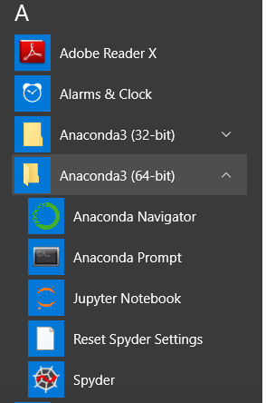

Slide 46
1. ANACONDA NAVIGATOR

Slide 47
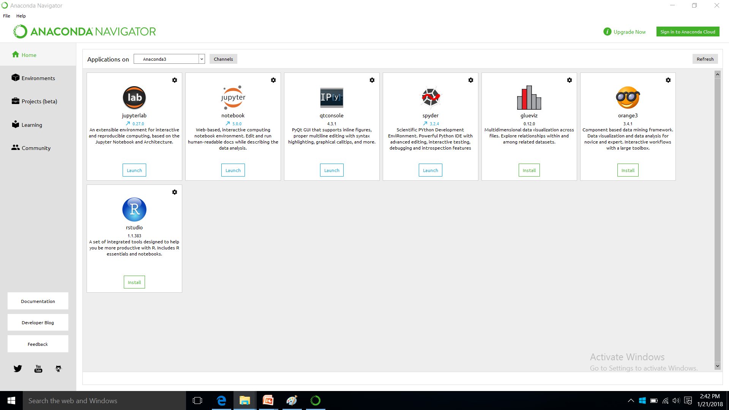

Slide 48
2. ANACONDA PROMPT

Slide 49
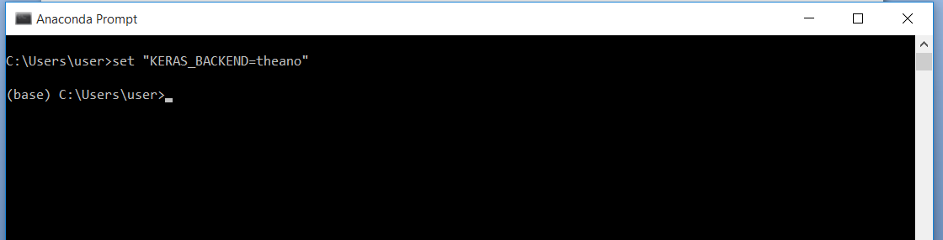

Slide 50
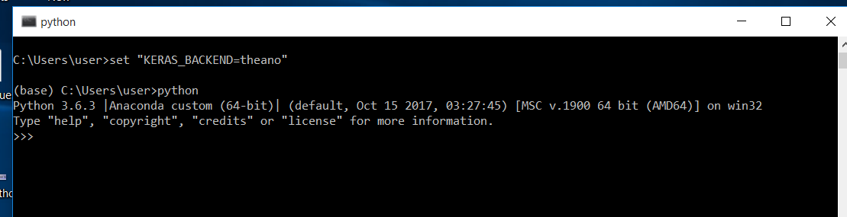

Slide 51
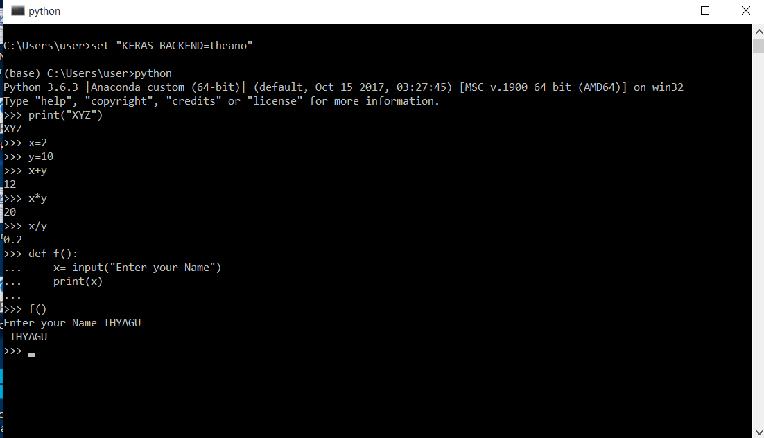

Slide 52
3. JUPYTER NOTEBOOK

Slide 53
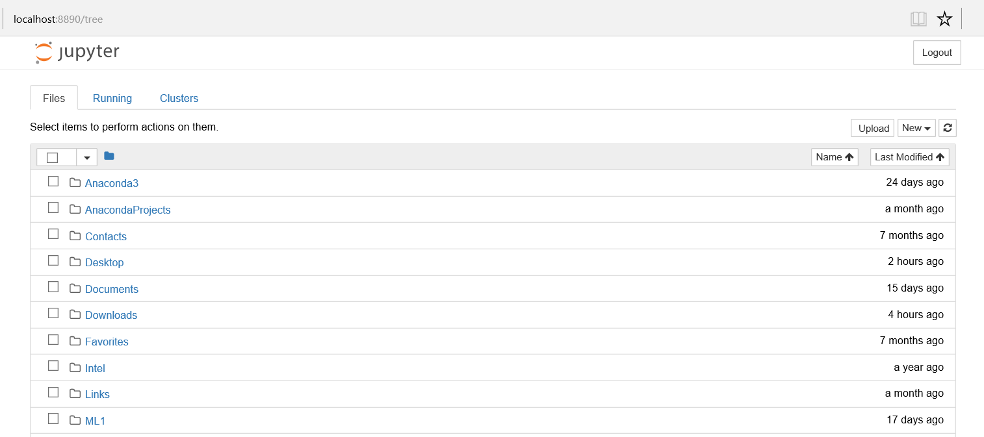

Slide 54
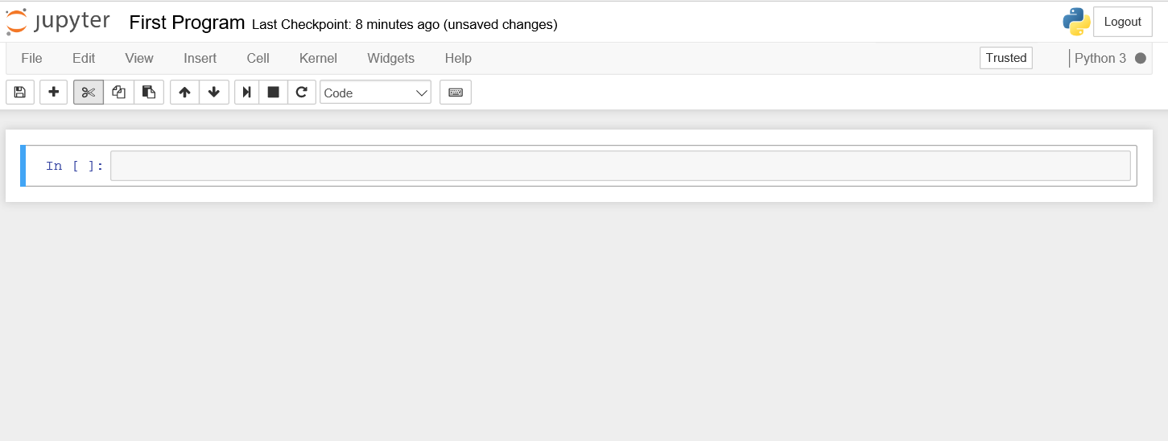

Slide 55
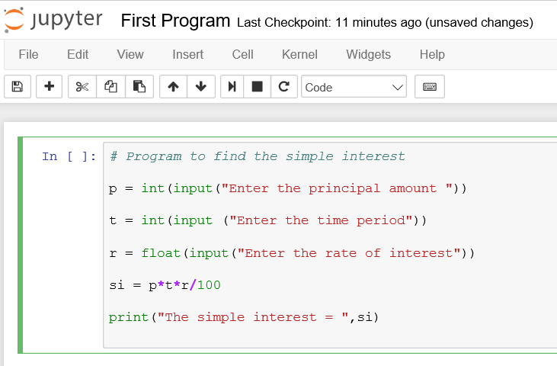

Slide 56
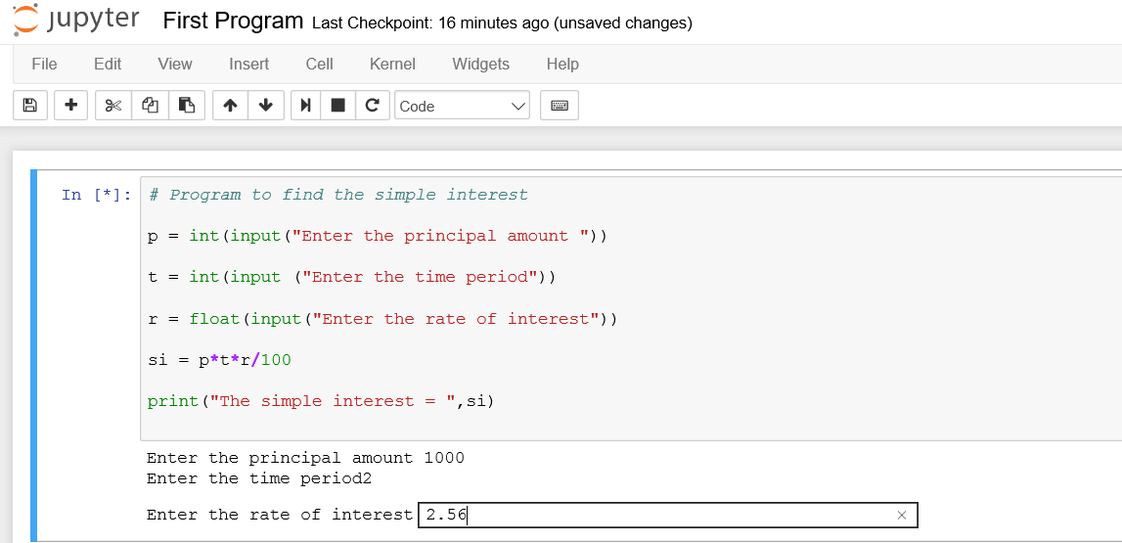

Slide 57
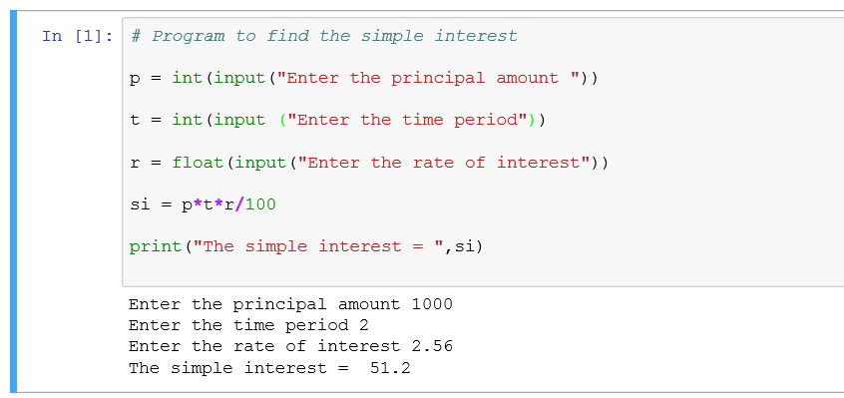

Slide 58
Try this
To read two numbers and find add, sub, mul, dev and mod dev.
To check whether the given number is even or odd.

Slide 59
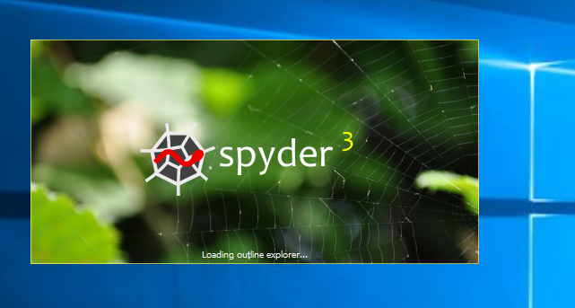

Slide 60
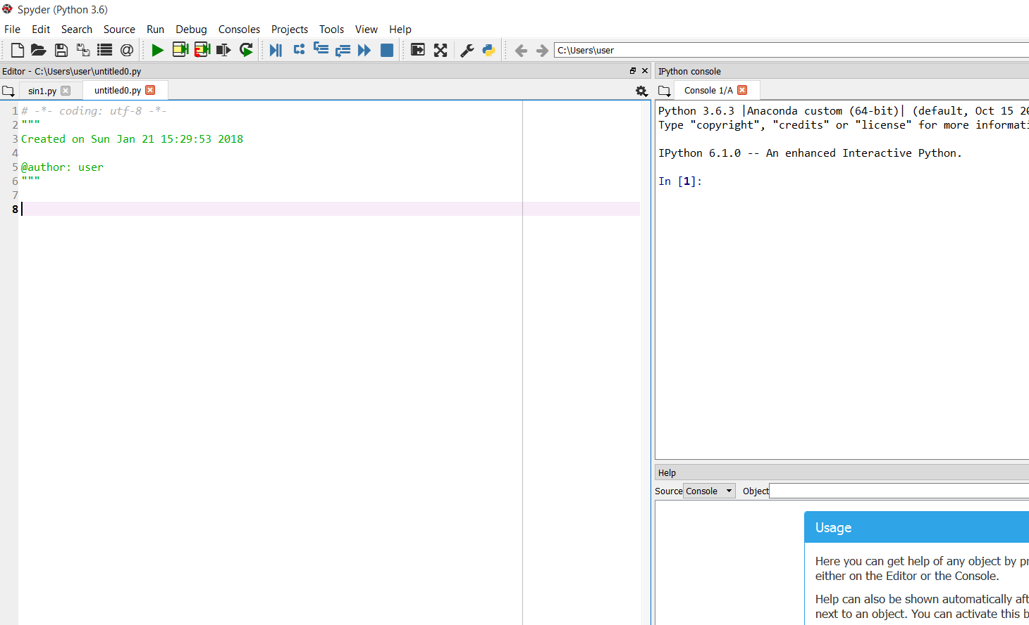

Slide 61
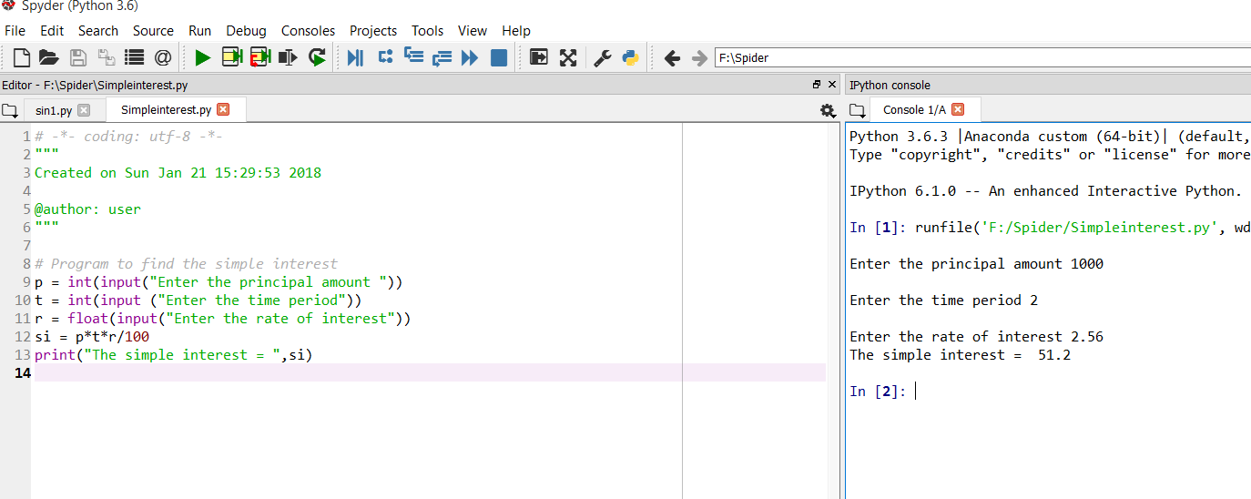

Slide 62
Try this in Spyder
import numpy as np
import matplotlib.pyplot as plt
# Sine Wave
x = np.arange(0,12*np.pi,0.001)
y = np.sin(x)
plt.plot(x,y)
plt.show()
#Cos Wave
y = np.cos(x)
plt.plot(x,y)
plt.show()
#Tan Wave
y = np.tan(x)
plt.plot(x,y)
plt.show()

Slide 63
Try this in Jupyter
import numpy as np
import matplotlib.pyplot as plt
# Sine Wave
x = np.arange(0,12*np.pi,0.001)
y = np.sin(x)
plt.plot(x,y)
plt.show()
#Cos Wave
y = np.cos(x)
plt.plot(x,y)
plt.show()
#Tan Wave
y = np.tan(x)
plt.plot(x,y)
plt.show()

Slide 64
Try the following in jupyter
import pandas as pd
df = pd.DataFrame({
'A1': ['a', 'b', 'c', 'd','e', 'f', 'g', 'h','i'],
'A2': [4, 3, 5, 2, 1, 7, 7, 5, 9],
'A3': [0, 4, 3, 6, 7, 10, 11, 9, 13],
'A4': [1, 2, 3, 1, 2, 3, 1, 2, 3]
})
print(df)

Slide 65
Different Modes
Immediate mode (Command Prompt)
Script mode (Idle)
IDE mode (Jupyter , Spyder and Pycharm)

Slide 66
Deleivered
Basic Concepts of Brain ,
What is Artificial Intelligence?
What is Machine Learning?
Machine Learning Life Cycle.
Types of Machine Learning?
Python 3.6 ( Interactive and Script mode)
Simple programs in Python

